Slide 1

Need of Maths in Chemistry
Submitted by:
-Sakshi, Poorvi, Himanshu, Tanu
(BSC Biotechnology 1st Year)

Slide 2
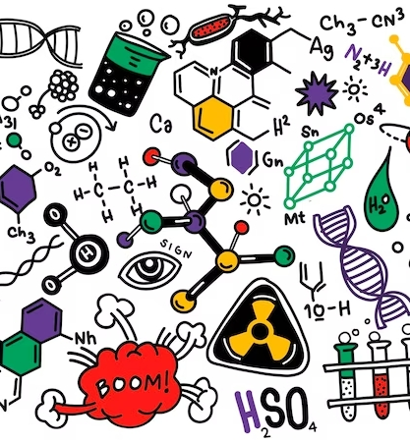
Introduction
Chemistry heavily relies on mathematics.
Accurate predictions, data analysis, and problem-solving are essential in chemistry.
This presentation explores key mathematical concepts in chemistry.

Slide 3
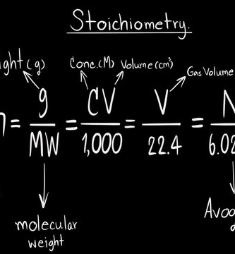
Stoichiometry:
Stoichiometry: Determines quantities in chemical reactions.
Molar mass: Key for stoichiometric calculations.
Example: Solving a stoichiometry problem.

Slide 4
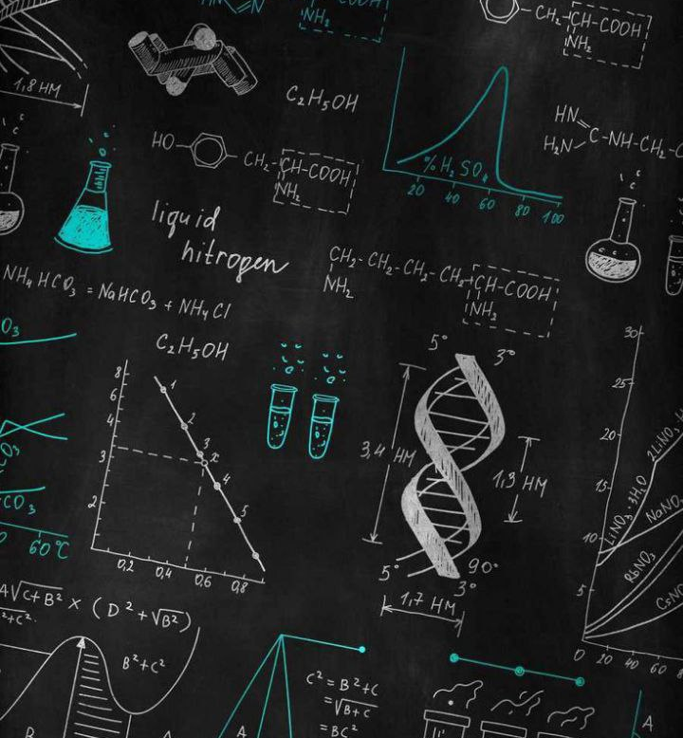
Percent Composition:
Calculates element percentages in compounds.
Importance in identifying substances.
Example: Calculating percent composition.

Slide 5

The Ideal Gas Law:
Ideal Gas Law (PV = nRT) describes gas behavior.
Predicts pressure, volume, or quantity of gas.
Example: Using the ideal gas law in a scenario.

Slide 6
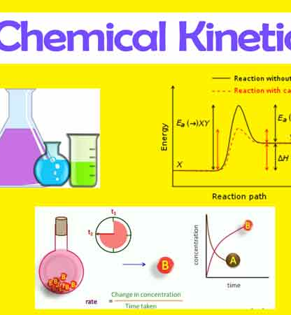
Chemical Kinetics:
Mathematical aspects of reaction rates.
Reaction order and rate constants.
Modeling reaction rates.

Slide 7
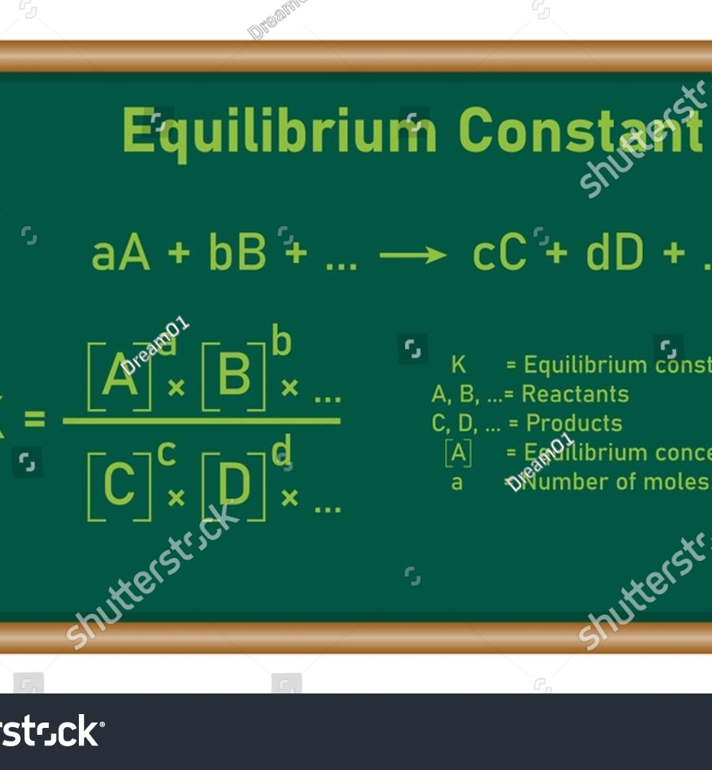
Equilibrium Constants:
Equilibrium concept and constants (Kc, Kp).
Predicting reaction direction.
Example: Calculating equilibrium constants.

Slide 8
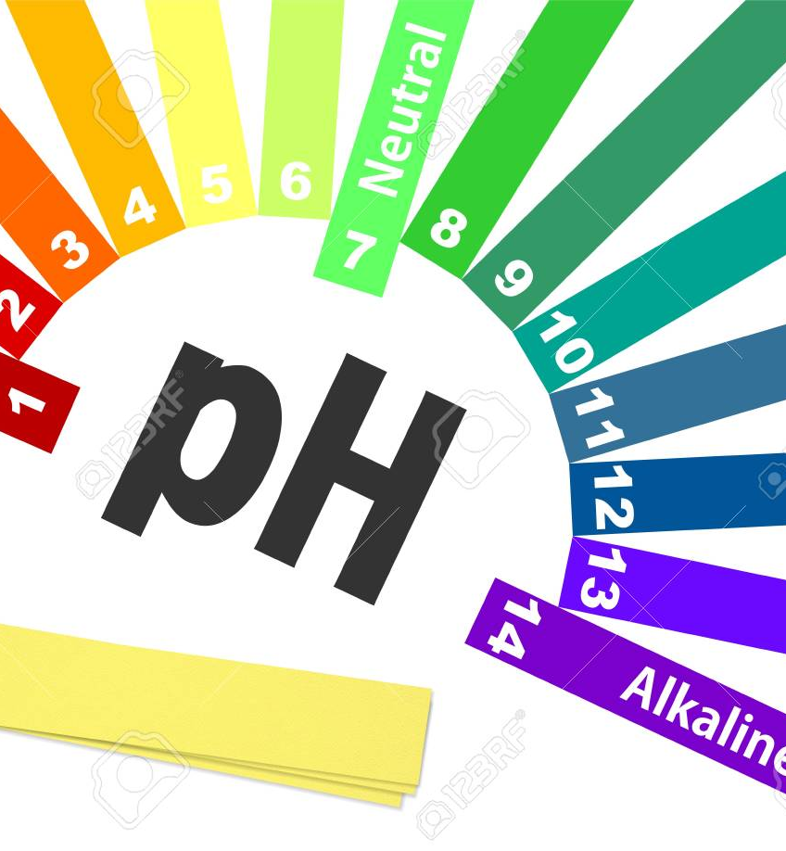
pH and Acid-Base Equilibria:
pH relates to hydrogen ion concentration.
Acid-base titration calculations.
Examples: pH calculations and titration curves.

Slide 9
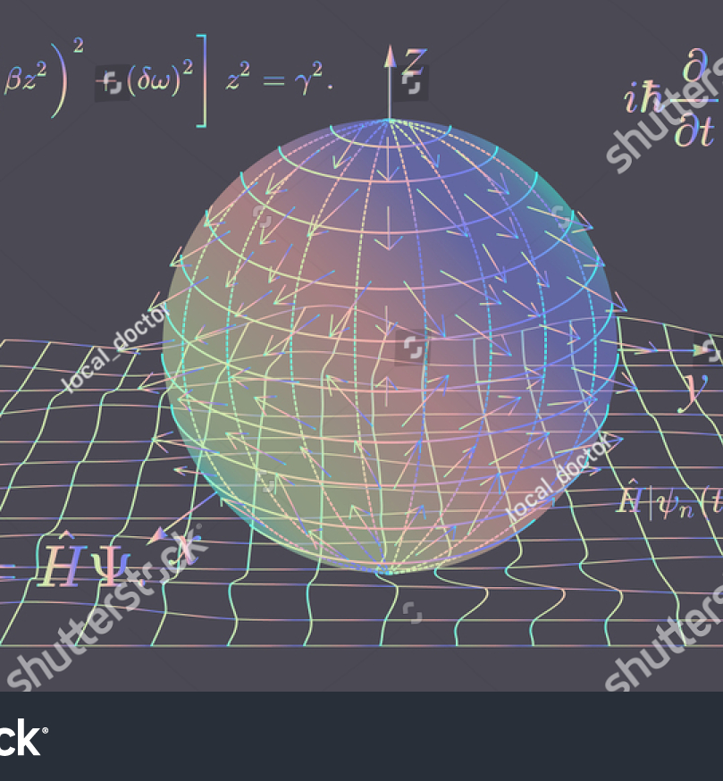
Quantum Mechanics:
Quantum mechanics foundation in chemistry.
Wave functions and energy levels.
Predicting atomic and molecular behavior.

Slide 10
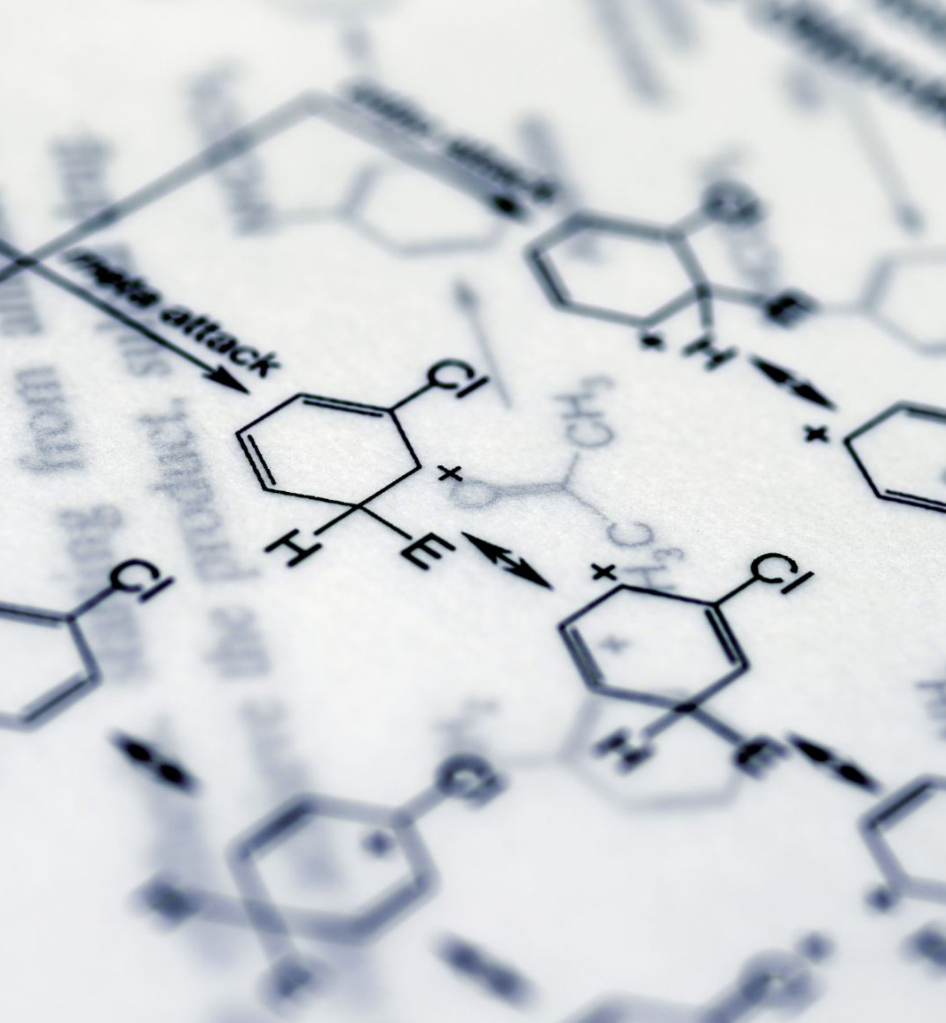
Conclusion:
Mathematics integral in chemistry for precision.
Enables precise measurements and modeling.
Encourage exploration of the math-chemistry link.

Slide 11

Thank you

